Slide 1
INTRODUCTION TO BIG DATA TECHNOLOGIES
MODULE - 1

Slide 2
Contents
History of Hadoop-Hadoop use cases,
Distributed File system
HDFS architecture
The Design of HDFS
Name node and data node
Blocks and replication management
Rack awareness
HDFS Federation
Anatomy of File write
Anatomy of File read.

Slide 3
Hadoop
Hadoop is an open-source software framework used for storing and processing Big Data in a distributed manner on large clusters of commodity hardware.
Hadoop is licensed under the Apache v2 license.
Hadoop was developed, based on the paper written by Google on the MapReduce system and it applies concepts of functional programming.
Hadoop is written in the Java programming language and ranks among the highest-level Apache projects.
Hadoop was developed by Doug Cutting and Michael J. Cafarella.

Slide 4
USE CASE OF HADOOP
The ClickStream analysis using Hadoop provides three key benefits:
Hadoop helps to join ClickStream data with other data sources such as Customer Relationship Management Data (Customer Demographics Data, Sales Data, and Information on Advertising Campaigns). This additional data often provides the much needed information to understand customer behavior.
Hadoop's scalability property helps you to store years of data without ample incremental cost. This helps you to perform temporal or year over year analysis on Click Stream data which your competitors may miss.
Business analysts can use Apache Pig or Apache Hive for website analysis. With these tools, you can organize ClickStream data by user session, refine it, and feed it to visualization or analytics tools.

Slide 5
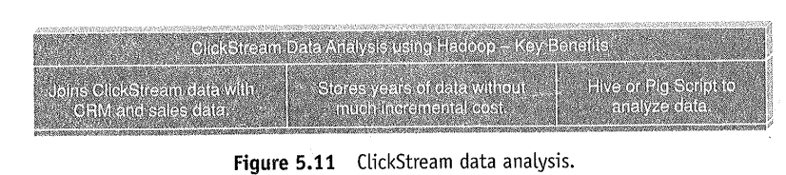
USE CASE OF HADOOP
ClickStream data (mouse clicks) helps you to understand the purchasing behavior of customers.
ClickStream analysis helps online marketers to optimize their product web pages, promotional content, etc. to improve their business.

Slide 6
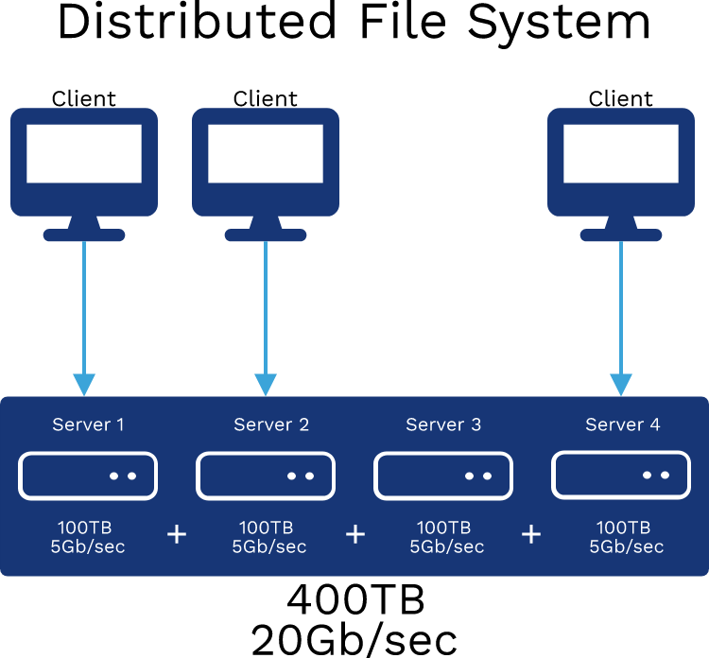
Distributed File System
A distributed file system (DFS) is a file system that is distributed on various file servers and locations.
It permits programs to access and store isolated data in the same method as in the local files.
It also permits the user to access files from any system.
It allows network users to share information and files in a regulated and permitted manner. Although, the servers have complete control over the data and provide users access control.

Slide 7
Distributed File System
DFS's primary goal is to enable users of physically distributed systems to share resources and information through the Common File System (CFS).
It is a file system that runs as a part of the operating systems. Its configuration is a set of workstations and mainframes that a LAN connects.

Slide 8
Distributed File System
DFS has two components in its services, and these are as follows:
Local Transparency
It is achieved via the namespace component.
Redundancy
It is achieved via a file replication component.
In the case of failure or heavy load, these components work together to increase data availability by allowing data from multiple places to be logically combined under a single folder known as the "DFS root".
It is not required to use both DFS components simultaneously; the namespace component can be used without the file replication component, and the file replication component can be used between servers without the namespace component.

Slide 9
Applications of Distributed File System
There are several applications of the distributed file system. Some of them are as follows:
Hadoop
Hadoop is a collection of open-source software services.
It is a software framework that uses the MapReduce programming style to allow distributed storage and management of large amounts of data.
Hadoop is made up of a storage component known as Hadoop Distributed File System (HDFS). It is an operational component based on the MapReduce programming model.
NFS (Network File System)
A client-server architecture enables a computer user to store, update, and view files remotely.
It is one of various DFS standards for Network-Attached Storage.

Slide 10
Applications of Distributed File System
SMB (Server Message Block)
IBM developed an SMB protocol to file sharing.
It was developed to permit systems to read and write files to a remote host across a LAN.
The remote host's directories may be accessed through SMB and are known as "shares".
NetWare
It is an abandon computer network operating system that is developed by Novell, Inc.
The network protocol mainly used combined multitasking to execute many services on a computer system.

Slide 11
Hadoop Distributed File System
HDFS (Hadoop Distributed File System) is a unique design that provides storage for extremely large files with streaming data access pattern and it runs on commodity hardware. Let’s elaborate the terms:
Extremely large files: Here we are talking about the data in range of petabytes(1000 TB).
Streaming Data Access Pattern: HDFS is designed on principle of write-once and read-many-times. Once data is written large portions of dataset can be processed any number times.
Commodity hardware: Hardware that is inexpensive and easily available in the market. This is one of feature which specially distinguishes HDFS from other file system

Slide 12
Hadoop Distributed File System
Nodes: Master-slave nodes typically forms the HDFS cluster.
NameNode (MasterNode):
  Manages all the slave nodes and assign work to them.
  It executes file system namespace operations like opening, closing, renaming files and directories.
  It should be deployed on reliable hardware which has the high config. not on commodity hardware.
DataNode(SlaveNode):
Actual worker nodes, who do the actual work like reading, writing, processing etc.
They also perform creation, deletion, and replication upon instruction from the master.
They can be deployed on commodity hardware

Slide 13
Hadoop Distributed File System
HDFS daemons: Daemons are the processes running in background.
Namenodes:
Run on the master node.
Store metadata (data about data) like file path, the number of blocks, block Ids. etc.
Require high amount of RAM.
Store meta-data in RAM for fast retrieval i.e to reduce seek time. Though a persistent copy of it is kept on disk
DataNodes:
  Run on slave nodes.
  Require high memory as data is actually stored here.

Slide 14
Hadoop Distributed File System
Functions of Data Node
These are slave daemons or process which runs on each slave machine.
The actual data is stored on Data Nodes.
The Data Nodes perform the low-level read and write requests from the file system’s clients.
They send heartbeats to the Name Node periodically to report the overall health of HDFS, by default, this frequency is set to 3 seconds.

Slide 15
Hadoop Distributed File System
SECONDARY NAMENODE
The secondary Namenode is one which constantly reads all the file system and metadata from the RAM of the NameNode and writes it on the Hard disk.
It is responsible for combining the edit logs and fsimage rom namenode.
Downloads the editlogs t regular interval and applies to fsimage.
The new fsimage is used whenever the namenode is started again.

Slide 16
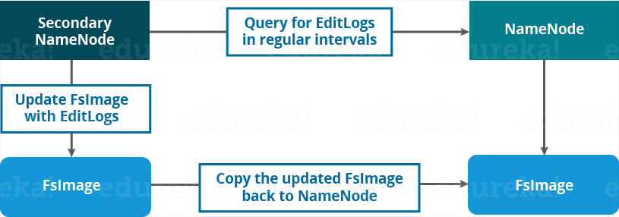
Hadoop Distributed File System
Secondary Name Node:
Apart from these two daemons, there is a third daemon or a process called Secondary Name Node.
The Secondary Name Node works concurrently with the primary Name Node as a helper daemon.
Secondary Name Node is not being a backup Name Node.

Slide 17
Hadoop Distributed File System
Functions of Secondary Name Node:
The Secondary Name Node is one which constantly reads all the file systems and metadata from the RAM of the Name Node and writes it into the hard disk or the file system.
It is responsible for combining the EditLogs with FsImage from the Name Node.
It downloads the EditLogs from the Name Node at regular intervals and applies to FsImage. The new FsImage is copied back to the Name Node, which is used whenever the Name Node is started the next time.
Hence, Secondary Name Node performs regular checkpoints(heart beat) in HDFS. Therefore, it is also called Checkpoint Node.

Slide 18
Blocks
Blocks are the nothing but the smallest continuous location on your hard drive where data is stored.
In general, in any of the File System, you store the data as a collection of blocks.
Similarly, HDFS stores each file as blocks which are scattered throughout the Apache Hadoop cluster.
The default size of each block is 128 MB in Apache Hadoop 2.x (64 MB in Apache Hadoop 1.x) which you can configure as per our requirement.

Slide 19
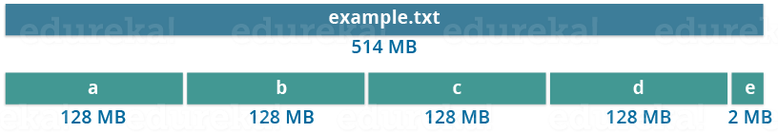
Blocks
It is not necessary that in HDFS, each file is stored in exact multiple of the configured block size (128 MB, 256 MB etc.).
Let’s take an example where I have a file “example.txt” of size 514 MB as shown in above figure.
Suppose that we are using the default configuration of block size, which is 128 MB. Then, how many blocks will be created? 5, Right.
The first four blocks will be of 128 MB. But, the last block will be of 2 MB size only.

Slide 20
Blocks
Well, whenever we talk about HDFS, we talk about huge data sets, i.e. Terabytes and Petabytes of data.
So, if we had a block size of let’s say of 4 KB, as in Linux file system, we would be having too many blocks and therefore too much of the metadata.
So, managing these no. of blocks and metadata will create huge overhead, which is something, we don’t want.

Slide 21
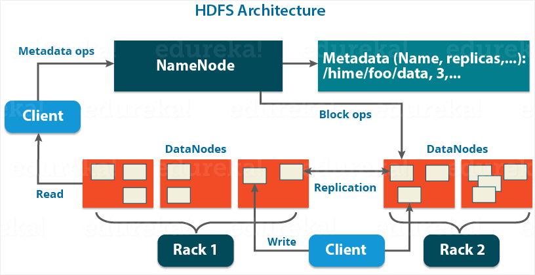

Slide 22
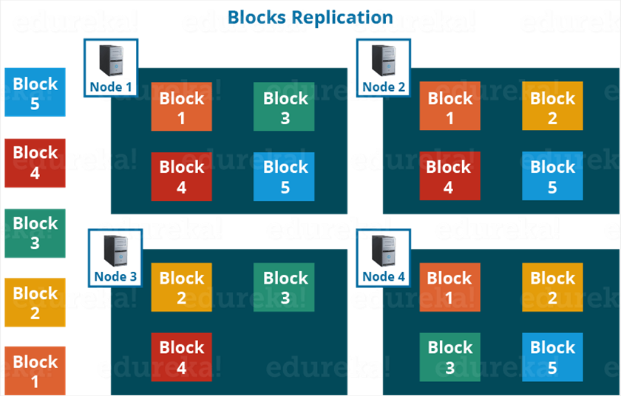
Replication Management
HDFS provides a reliable way to store huge data in a distributed environment as data blocks.
The blocks are also replicated to provide fault tolerance.
Replication is nothing but making a copy of something and the number of times you make a copy of that particular thing can be expressed as its Replication Factor.
The default replication factor is 3 which is again configurable.
So, as you can see in the figure below where each block is replicated three times and stored on different Data Nodes (considering the default replication factor):

Slide 23
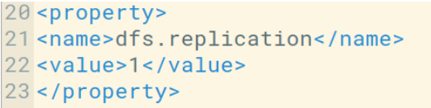
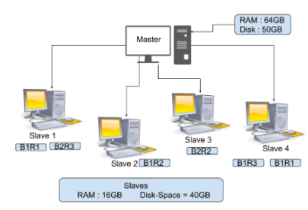
Replication Management
You can configure the Replication factor in you hdfs-site.xml file
How does Replication work?
Now suppose you have a file of size 150MB then the total file blocks will be 2 shown below
128MB = Block 1
22MB = Block 2.
As the replication factor by-default is 3 so we have 3 copies of this file block.
FileBlock1-Replica1(B1R1) FileBlock2-Replica1(B2R1) FileBlock1-Replica2(B1R2) FileBlock2-Replica2(B2R2) FileBlock1-Replica3(B1R3) FileBlock2-Replica3(B2R3)

Slide 24
Rack Awareness
The rack is a physical collection of nodes in our Hadoop cluster (maybe 30 to 40).
A large Hadoop cluster is consists of many Racks. With the help of this Racks information, Namenode chooses the closest Datanode to achieve maximum performance while performing the read/write information which reduces the Network Traffic.
The Hadoop itself is so smart that it will automatically write a particular file block in 2 different Data nodes in Rack.
Considering the replication factor is 3, the Rack Awareness Algorithm says that the first replica of a block will be stored on a local rack and the next two replicas will be stored on a different (remote) rack but, on a different Data Node within that (remote) rack as shown in the figure above.

Slide 25
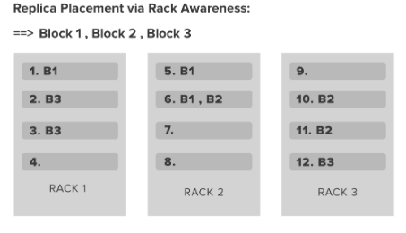
Rack Awareness
Communication between the Datanodes that are present on the same rack is quite much faster than the communication between the data node present at the 2 different racks.
The name node has the feature of finding the closest data node for faster performance for that Name node holds the ids of all the Racks present in the Hadoop cluster.
This concept of choosing the closest data node for serving a purpose is Rack Awareness.
In the above image, we have 3 different Racks in our Hadoop cluster each Rack contains 4 Datanode.

Slide 26
Rack Awareness
Now suppose you have 3 file blocks(Block 1, Block 2, Block 3) that you want to put in this data node.
By default, the Replication Factor is 3 so Hadoop is so smart that it will place the replica’s of Blocks in Racks in such a way that we can achieve a good network bandwidth. For that Hadoop has some Rack awareness policies.
There should not be more than 1 replica on the same Datanode.
More than 2 replica’s of a single block is not allowed on the same Rack.
The number of racks used inside a Hadoop cluster must be smaller than the number of replicas.

Slide 27
Rack Awareness
Benefits of Implementing Rack Awareness in our Hadoop Cluster:
With the rack awareness policy’s we store the data in different Racks so no way to lose our data.
Rack awareness helps to maximize the network bandwidth because the data blocks transfer within the Racks.
It also improves the cluster performance and provides high data availability.

Slide 28
Limitations of Hadoop 1.0 Architecture
HDFS Limitation
Name Node saves all its file metadata in main memory.
Although the main memory today is not as small and as expensive as it used to be two decades ago, still there is a limit on the number of objects that one can have in the memory on a single Name Node.
The Name Node can quickly become overwhelmed with load on the system increasing.
In Hadoop 2.x, this is resolved with the help of HDFS Federation

Slide 29
HDFS Federation
HDFS Federation uses multiple independent Name Nodes for horizontal scalability.
Name Nodes are independent of each other.
It means, Name Nodes does not need any coordination with each other. The Data Nodes are common storage for blocks and shared by all Name Nodes.
All Data Nodes in the cluster registers with each Name Node in the cluster.
High availability of Name Node is obtained with the help of Passive Standby Name Node.

Slide 30
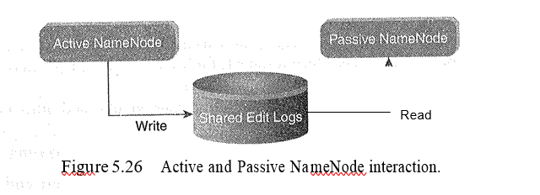
HDFS Federation
In Hadoop 2.x, Active-Passive Name Node handles failover automatically.
All namespace edits are recorded to a shared NFS Storage and there is a single writer at any point of time.
Passive Name Node reads edits from shared storage and keeps updated metadata information.
In case of Active Name Node failure, Passive Name Node become an Active Name Node automatically.
Then it starts writing to the shared storage.

Slide 31
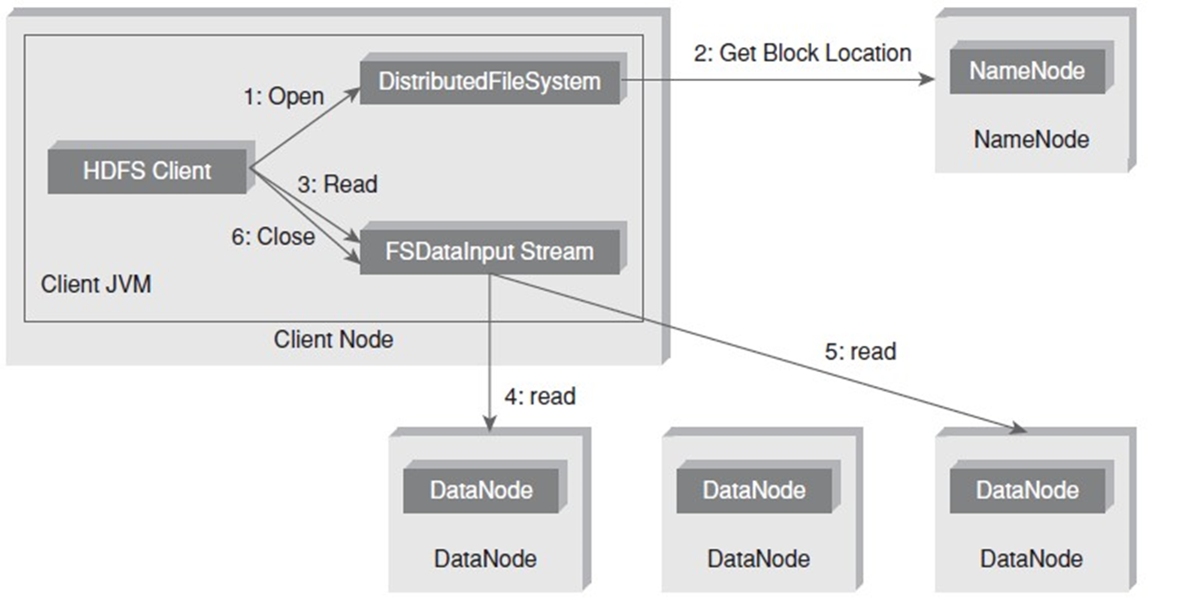
Anatomy of File Read

Slide 32
Anatomy of File Read
The steps involved in the File Read are as follows:
The client opens the file that it wishes to read from by calling open() on the Distributed File System.
Distributed File System communicates with the Name Node to get the location of data blocks.
  Name Node returns with the addresses of the Data nodes that the data blocks are stored on.
  Subsequent to this, the Distributed File system returns an FS Data lnput Stream to client to read from the file.
Client then calls read() on the stream DFSlnputStream, which has addresses of the Data nodes for the first few blocks of the file, connects to the closest Data node for the first block in the file.

Slide 33
Anatomy of File Read

Slide 34
Anatomy of File Read
4. Client calls read() repeatedly to stream the data from the Data node.
5. When end of the block is reached, DFSlnputStream closes the connection with the Datanode. It repeats the steps to find the best Data node for the next block and subsequent blocks.
5. When the client completes the reading of the file, it calls close() on the FSDatalnputStream to close the connection.

Slide 35
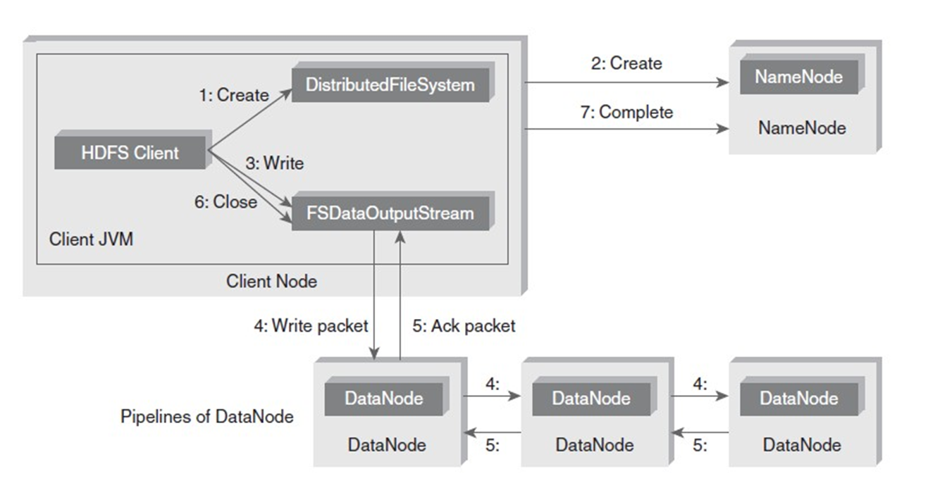
Anatomy of File Write

Slide 36
Anatomy of File Write
The steps involved in anatomy of File Write are as follows:
The client calls create() on Distributed File System to create a file.
An RPC call to the Name Node happens through the Distributed File System to create a new file.
  The Name Node performs various checks to create a new file (checks whether such a file exists or not).
  Initially, the Name Node creates a file without associating any data blocks to the file.
  The Distributed File System returns an FSDataOutputStream to the client to perform write.
As the client writes data, data is split into packets by DFSOutputStream, which is then written to an internal queue, called data queue.
  Data Streamer consumes the data queue.
  The DataStreamer requests the Name Node to allocate new blocks by selecting a list of suitable Data nodes to store replicas.
  This list of Data nodes makes a pipeline. Here, we will go with the default replication factor of three, so there will be three nodes in the pipeline for the first block.

Slide 37
Anatomy of File Write

Slide 38
Anatomy of File Write
DataStreamer streams the packets to the first Data node in the pipeline. It stores packet and forwards it to the second Data node in the pipeline. In the same way, the second Data node stores the packet and forwards it to the third Data node in the pipeline.
In addition to the internal queue, DFSOutputStream also manages an "Ack queue" of packets that are waiting for the acknowledgement by Data nodes. A packet is removed from the "Ack queue" only if it is acknowledged by all the Data nodes in the pipeline.
When the client finishes writing the file, it calls close() on the stream.
This flushes all the remaining packets to the Data node pipeline and waits for relevant acknowledgments before communicating with the Name Node to inform the client that the creation of the file is complete.

